Slide 1

Code Club 9/4/23

Slide 2
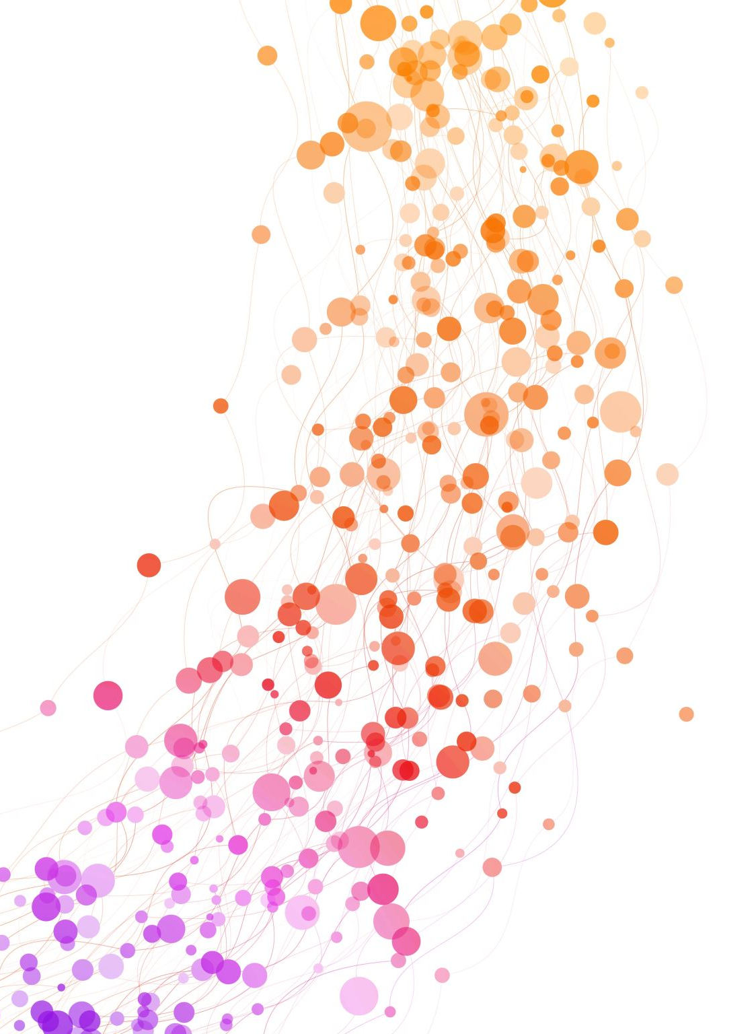
Weekly Showcase

Slide 3

This week in tech
“Techtober” coming!
Apple event Tuesday!
  https://www.zdnet.com/article/every-product-were-expecting-at-apples-september-event-iphone-15-apple-watch-ultra-2-airpods/
  iPhone 15, 15 plus, 15 pro, 15 pro max; Watch series 9, Watch Ultra 2; maybe new AirPods/iPad?
Chrome redesign
  https://arstechnica.com/gadgets/2023/09/chrome-is-getting-a-big-redesign-with-rounded-corners-material-you-colors/
Lenovo 3D monitor without glasses
  https://arstechnica.com/gadgets/2023/09/lenovo-adds-glasses-free-3d-to-a-27-inch-monitor-for-2999/

Slide 4


Slide 5
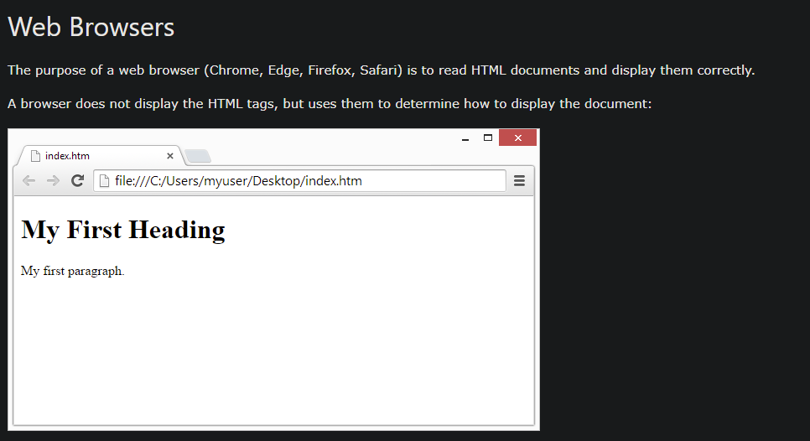
Why do we have web browsers?
All a browser does is display the contents of an HTML file (& many other features)
Some browsers display content differently, which is why some teachers recommend using blackboard on Chrome, not Firefox
To see the underlying HTML of a webpage, try using inspect element!

Slide 6
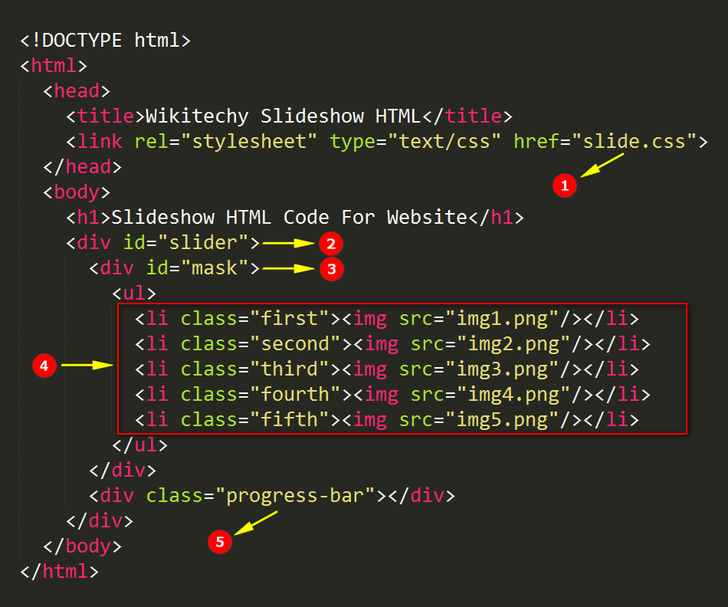
HTML - Hypertext Markup Language
A language for defining the content on the document (webpage) – but not the style or function
Uses tags to define the type of content
Tags are a name surrounded by angled bracket (e.g. section tag is <section>)

Slide 7
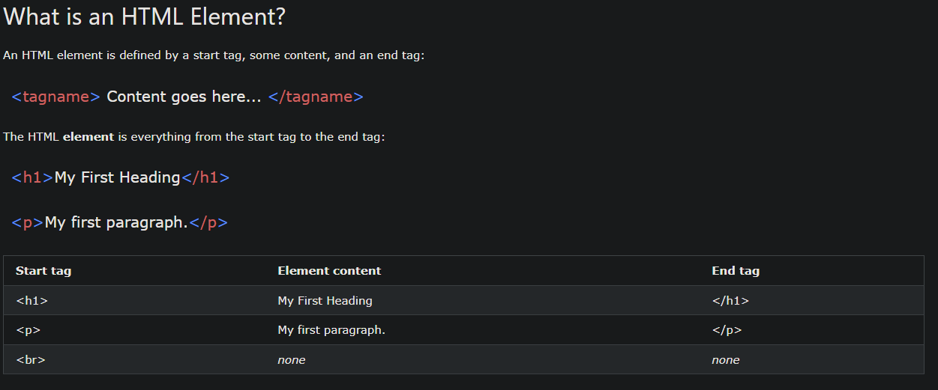
What is an HTML element?
HTML is normally structured as such:
  <tag>Some words in here</tag>
  <tag> is a tag and </tag> is a end tag
Content goes between the tags, no quotes or any other formatting necessary
Links for content also look like this

Slide 8
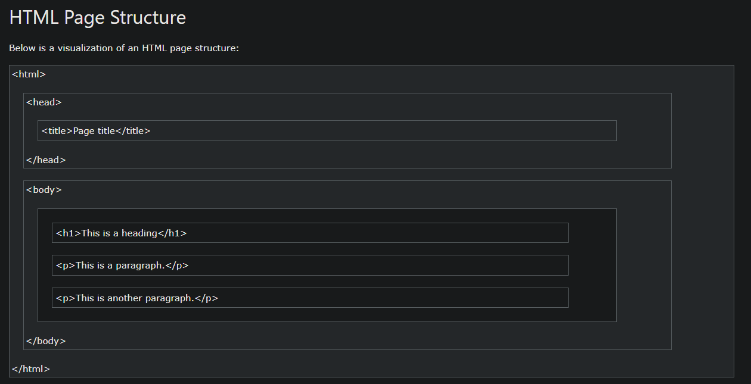

Slide 9
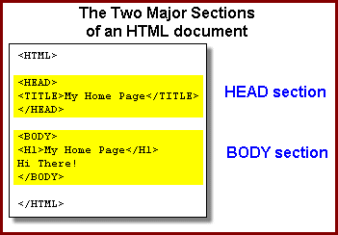
<head> and <body>
The head tag contains all the information ABOUT the file, like title, character encoding, etc.
  Almost like how we use ‘import’ for python to tell you what packages we are using?
The body tag contains all the contents
Ends with an end tag </head> or </body>
  Almost all tags use an end tag

Slide 10
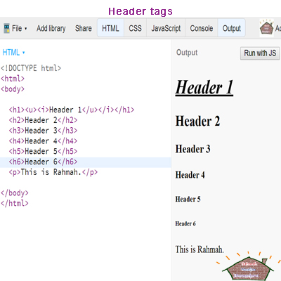
<section> and headers <h1>-<h6>
<section> is used to logically divide the document in sections, but has no visual effect
The <h1> through <h6> tags stand for <header 1-6> and create headers of various sizes (1 is the largest, 6 is the smallest)
<h1> - <h6> tags are usually used to label sections

Slide 11
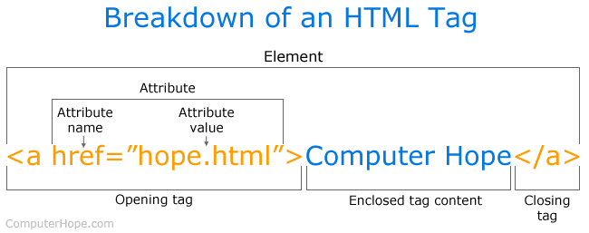
<p> and <a> tags
<p> defines a paragraph of text. Text does not require <p> tag, but anything longer than a sentence should have a <p> tag by convention.
<a> defines an anchor used to reference external content (an email, phone number, or another document)
<a> tags use the href attribute to link to the external content

Slide 12
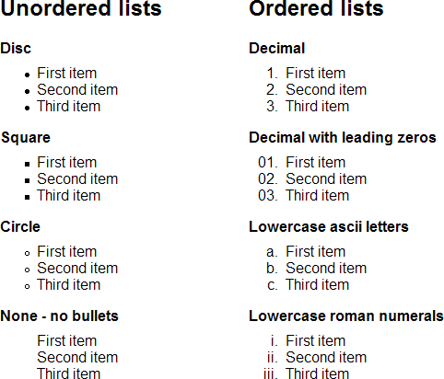
Lists
<ul>
  Unordered list
<ol>
  Ordered list
<li>
  Each item in a list is enclosed with <li></li>
By default, this is a bulleted list

Slide 13
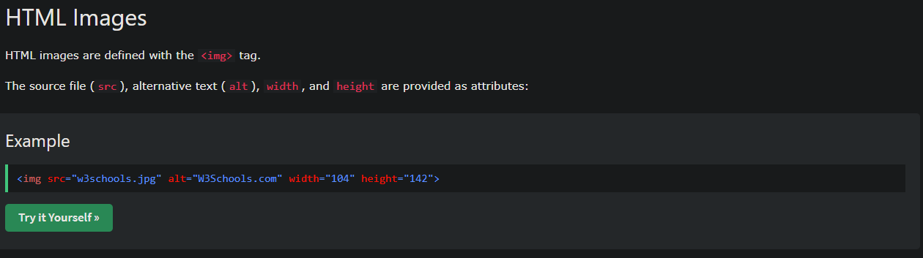

Slide 14
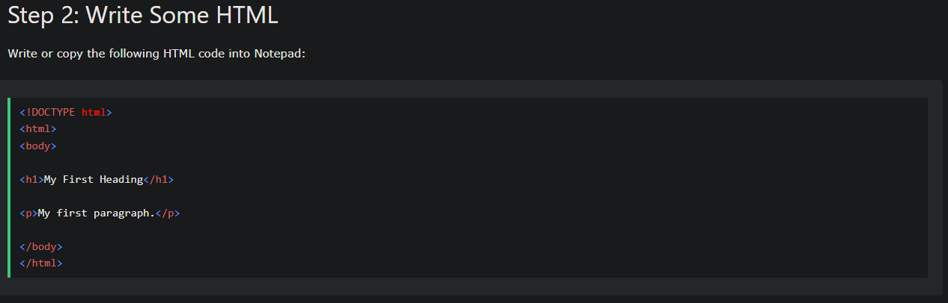
Generic HTML file example

Slide 15
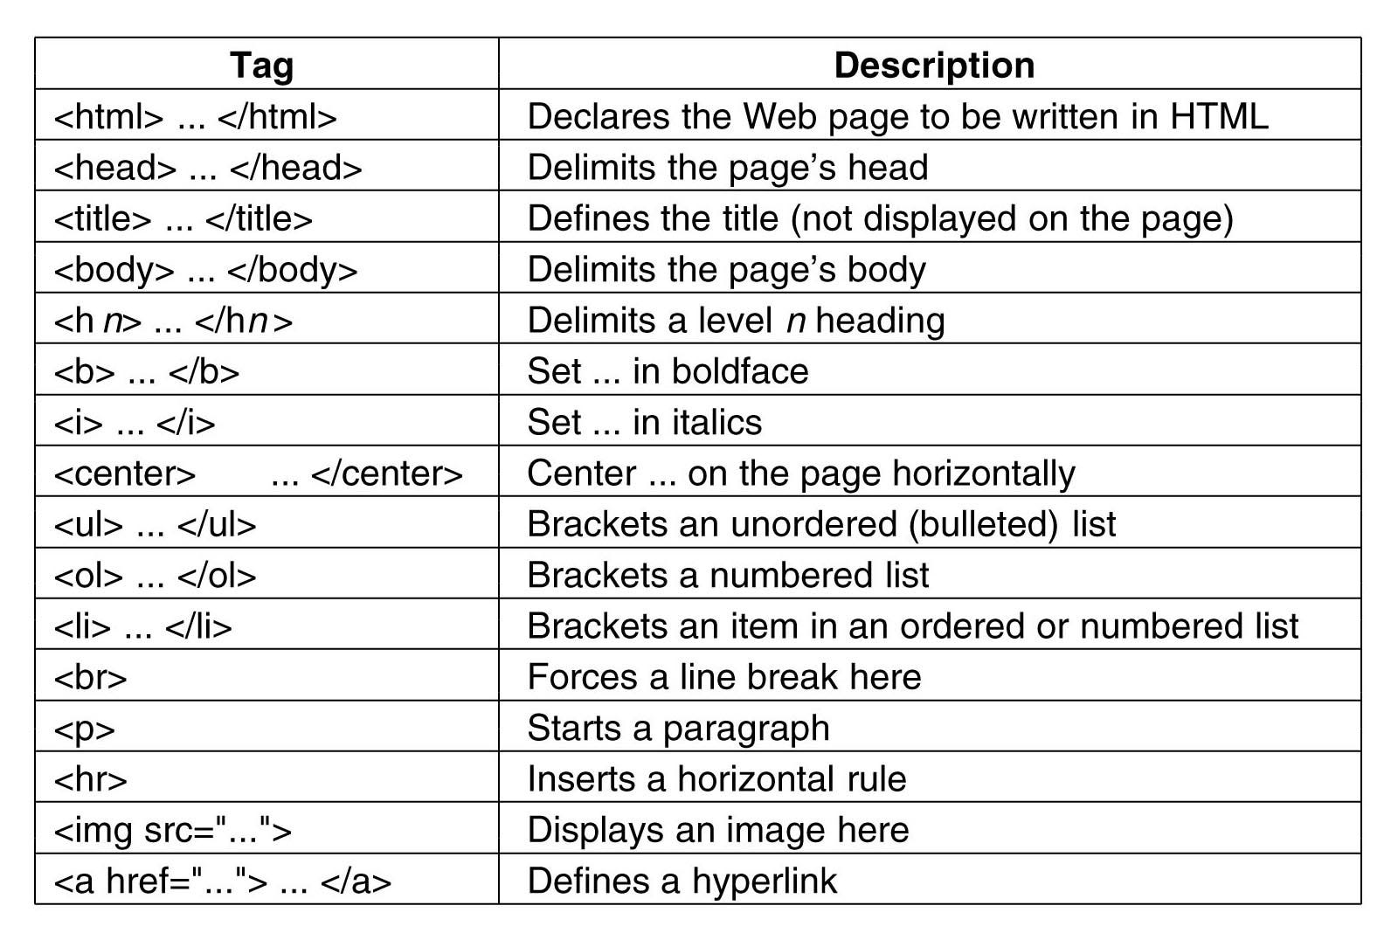

Slide 16
Get started!
https://www.w3schools.com/html/html_basic.asp
Notes:
Reminder to download html live server extension

Slide 17
